Slide 1
Strings, Lists, Tuples and Loops
Akash Hegde
Seventh Sense Talent Solutions
Vivekananda Institute of Technology
29 March 2021

Slide 2
Introduction to Strings
Strings are amongst the most popular types in Python.
We can create them simply by enclosing characters in quotes.
Python treats single quotes the same as double quotes.
Creating strings is as simple as assigning a value to a variable.
For example − var1 = ‘Hello World!’ var2 = “Python Programming”

Slide 3
Accessing Values in Strings
Python does not support a character type; these are treated as strings of length one, thus also considered a substring.
To access substrings, use the square brackets for slicing along with the index or indices to obtain your substring.
For example − #!/usr/bin/python var1 = ‘Hello World!’ var2 = “Python Programming” print "var1[0]: ", var1[0] print "var2[1:5]: ", var2[1:5]

Slide 4
Updating Values in Strings
You can "update" an existing string by (re)assigning a variable to another string.
The new value can be related to its previous value or to a completely different string altogether.
For example − #!/usr/bin/python var1 = ‘Hello World!’ print "Updated String :- ", var1[:6] + 'Python'

Slide 5
String Special Operators
Assume string variable a holds 'Hello' and variable b holds 'Python', then −
Operator | Description | Example
+ | Concatenation - Adds values on either side of the operator | a + b will give HelloPython
* | Repetition - Creates new strings, concatenating multiple copies of the same string | a*2 will give -HelloHello
[] | Slice - Gives the character from the given index | a[1] will give e
[ : ] | Range Slice - Gives the characters from the given range | a[1:4] will give ell

Slide 6
String Formatting Operator
This operator (%) is unique to strings and makes up for the pack of having functions from C's printf() family.
For example − #!/usr/bin/python print "My name is %s and age is %d." % (‘ABC', 15)
Format Symbol | Conversion
%c | character
%s | string conversion via str() prior to formatting
%i or %d | signed decimal integer
%u | unsigned decimal integer
%o | octal integer
%x or %X | hexadecimal integer (lowercase and uppercase letters)
%e or %E | exponential notation (lowercase and uppercase)
%f | floating point real number

Slide 7
Raw Strings
Raw strings do not treat the backslash (\) as a special character at all.
Every character you put into a raw string stays the way you wrote it.
For example − #!/usr/bin/python print r‘C:\\somepath’

Slide 8
String Methods
capitalize() – Capitalizes first letter of string
center(width, fillchar) – Returns a space-padded string with the original string centered to a total of width columns.
count(str, beg=0, end=len(string)) – Counts how many times str occurs in string or in a substring of string if starting index beg and ending index end are given.
encode(encoding=‘UTF-8’, errors=‘strict’) – Returns encoded string version of string; on error, default is to raise a ValueError unless errors is given with 'ignore' or 'replace'.
decode(encoding=‘UTF-8’, errors=‘strict’) – Decodes the string using the codec registered for encoding. encoding defaults to the default string encoding.

Slide 9
String Methods
endswith(suffix, beg=0, end=len(string)) - Determines if string or a substring of string (if starting index beg and ending index end are given) ends with suffix; returns true if so and false otherwise.
find(str, beg=0, end=len(string)) - Determine if str occurs in string or in a substring of string if starting index beg and ending index end are given returns index if found and -1 otherwise.
len(string) - Returns the length of the string
lower() - Converts all uppercase letters in string to lowercase.
upper() – Converts lowercase letters in string to uppercase.

Slide 10
String Methods
lstrip() – Removes all leading whitespace in string.
rstrip() – Removes all trailing whitespace in string.
split(str=“”, num=string.count(str)) – Splits string according to delimiter str (space if not provided) and returns list of substrings; split into at most num substrings if given.
max(str) – Returns the max alphabetical character from the string str.
min(str) – Returns the min alphabetical character from the string str.

Slide 11
Introduction to Lists
The list is the most versatile datatype available in Python which can be written as a list of comma-separated values (items) between square brackets.
Items in a list need not be of the same type.
Creating a list is as simple as putting different comma-separated values between square brackets.
For example − list1 = ['physics', 'chemistry', 1997, 2000] list2 = [1, 2, 3, 4, 5 ] list3 = ["a", "b", "c", "d"]
Similar to string indices, list indices start at 0, and lists can be sliced, concatenated and so on.

Slide 12
Accessing Values in Lists
To access values in lists, use the square brackets for slicing along with the index or indices to obtain value available at that index.
For example − #!/usr/bin/python list1 = ['physics', 'chemistry', 1997, 2000] list2 = [1, 2, 3, 4, 5, 6, 7 ] print "list1[0]: ", list1[0] print "list2[1:5]: ", list2[1:5]

Slide 13
Updating Values in Lists
You can update single or multiple elements of lists by giving the slice on the left-hand side of the assignment operator, and you can add to elements in a list with the append() method.
For example − #!/usr/bin/python list = ['physics', 'chemistry', 1997, 2000] print "Value available at index 2 : “ print list[2] list[2] = 2001 print "New value available at index 2 : “ print list[2]

Slide 14
Basic List Operations
Python Expression | Results | Description
len([1, 2, 3]) | 3 | Length
[1, 2, 3] + [4, 5, 6] | [1, 2, 3, 4, 5, 6] | Concatenation
['Hi!'] * 4 | ['Hi!', 'Hi!', 'Hi!', 'Hi!'] | Repetition
3 in [1, 2, 3] | True | Membership
for x in [1, 2, 3]: print x, | 1 2 3 | Iteration

Slide 15
Indexing, Slicing and Matrices
Because lists are sequences, indexing and slicing work the same way for lists as they do for strings.
Assuming following input − L = ['spam', 'Spam', 'SPAM!']
Python Expression | Results | Description
L[2] | SPAM! | Offsets start at zero
L[-2] | Spam | Negative: count from the right
L[1:] | ['Spam', 'SPAM!'] | Slicing fetches sections

Slide 16
List Methods
cmp(list1, list2) – Compares elements of both lists.
len(list) – Gives the total length of the list.
max(list) – Returns item from the list with max value.
min(list) - Returns item from the list with min value.
list(seq) - Converts a tuple into list.
list.append(obj) - Appends object obj to list
list.count(obj) - Returns count of how many times obj occurs in list
list.extend(seq) - Appends the contents of seq to list

Slide 17
List Methods
list.insert(index, obj) – Inserts object obj into list at offset index.
list.pop(obj=list[-1]) - Removes and returns last object obj from list
list.remove(obj) - Removes object obj from list
list.reverse() - Reverses objects of list in place
list.sort([func]) – Sorts objects of list, use compare function if given

Slide 18
Introduction to Tuples
A tuple is a collection of objects which is ordered and immutable.
Tuples are sequences, just like lists.
The differences between tuples and lists are, the tuples cannot be changed unlike lists and tuples use parentheses, whereas lists use square brackets.
Creating a tuple is as simple as putting different comma-separated values.
Optionally you can put these comma-separated values between parentheses also.

Slide 19
Introduction to Tuples
For example − tup1 = ('physics', 'chemistry', 1997, 2000) tup2 = (1, 2, 3, 4, 5 ) tup3 = "a", "b", "c", "d“
The empty tuple is written as two parentheses containing nothing − tup1 = ()
To write a tuple containing a single value you have to include a comma, even though there is only one value − tup1 = (50,)
Like string indices, tuple indices start at 0, and they can be sliced, concatenated, and so on.

Slide 20
Accessing Values in Tuples
To access values in tuple, use the square brackets for slicing along with the index or indices to obtain value available at that index.
For example − #!/usr/bin/python tup1 = ('physics', 'chemistry', 1997, 2000) tup2 = (1, 2, 3, 4, 5, 6, 7 ) print "tup1[0]: ", tup1[0] print "tup2[1:5]: ", tup2[1:5]

Slide 21
Basic Tuples Operations
Python Expression | Results | Description
len((1, 2, 3)) | 3 | Length
(1, 2, 3) + (4, 5, 6) | (1, 2, 3, 4, 5, 6) | Concatenation
('Hi!',) * 4 | ('Hi!', 'Hi!', 'Hi!', 'Hi!') | Repetition
3 in (1, 2, 3) | True | Membership
for x in (1, 2, 3): print x, | 1 2 3 | Iteration

Slide 22
Basic Tuples Operations
Because tuples are sequences, indexing and slicing work the same way for tuples as they do for strings.
Assuming following input − L = ('spam', 'Spam', 'SPAM!')
Python Expression | Results | Description
L[2] | 'SPAM!' | Offsets start at zero
L[-2] | 'Spam' | Negative: count from the right
L[1:] | ['Spam', 'SPAM!'] | Slicing fetches sections

Slide 23
Tuple Methods
cmp(tuple1, tuple2) – Compares elements of both tuples.
len(tuple) – Gives the total length of the tuple.
max(tuple) - Returns item from the tuple with max value.
min(tuple) - Returns item from the tuple with min value.
tuple(seq) - Converts a list into tuple.

Slide 24
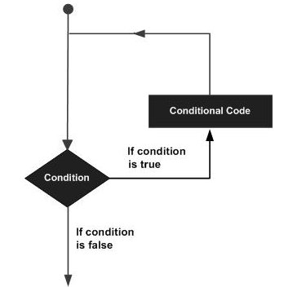
Loops
A loop statement allows us to execute a statement or group of statements multiple times.
The following diagram illustrates a loop statement −

Slide 25
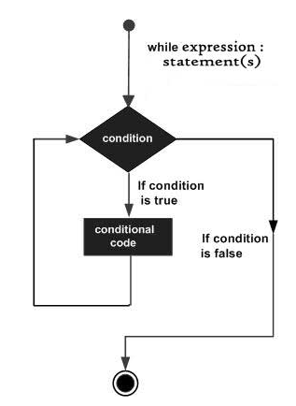
while Loop
Repeats a statement or group of statements while a given condition is TRUE.
It tests the condition before executing the loop body.
Syntax: while expression: statement(s)

Slide 26
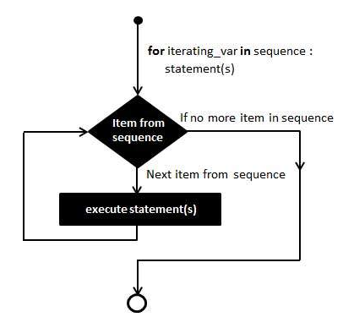
for Loop
Executes a sequence of statements multiple times and abbreviates the code that manages the loop variable.
Syntax: for iterating_var in sequence: statement(s)

Slide 27
Thank you!

